Slide 1
Plant Families

Slide 2
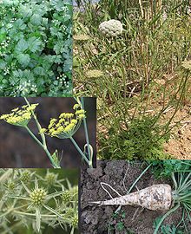
Apiaceae (Umbelliferae)
Carrot or Parsley family
Carrot, wild carrot, parsley, Queen Anne’s Lace

Slide 3
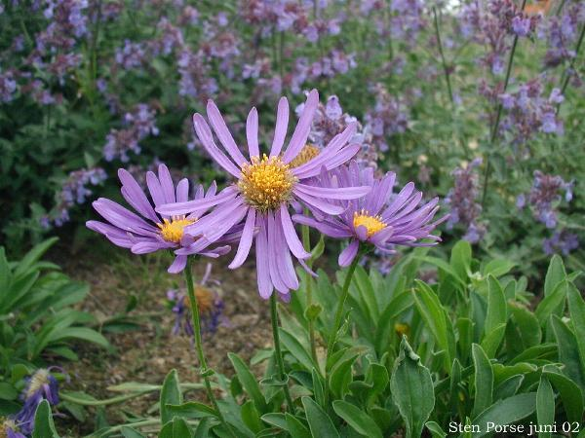
Asteraceae (Compositae)
Sunflower and Aster Family
Sunflowers, aster, black eyed, mule’s ear

Slide 4
Boraginaceae
Forget-me-not family
Hound’s tongue,

Slide 5
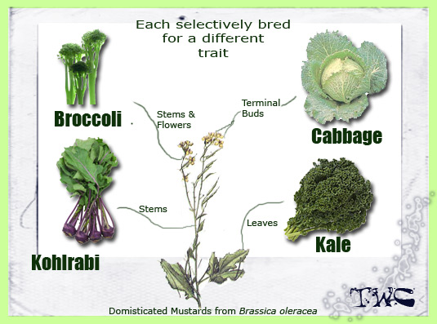
Brassicaceae (Cruciferae)
Mustard family

Slide 6
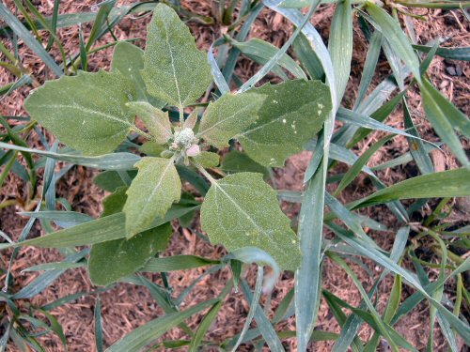
Chenopodiaceae
Goosefoot family
Vast majority are weeds.
Lamb’s Quarters, four-wing saltbush
Spinach, Beets, Chard

Slide 7
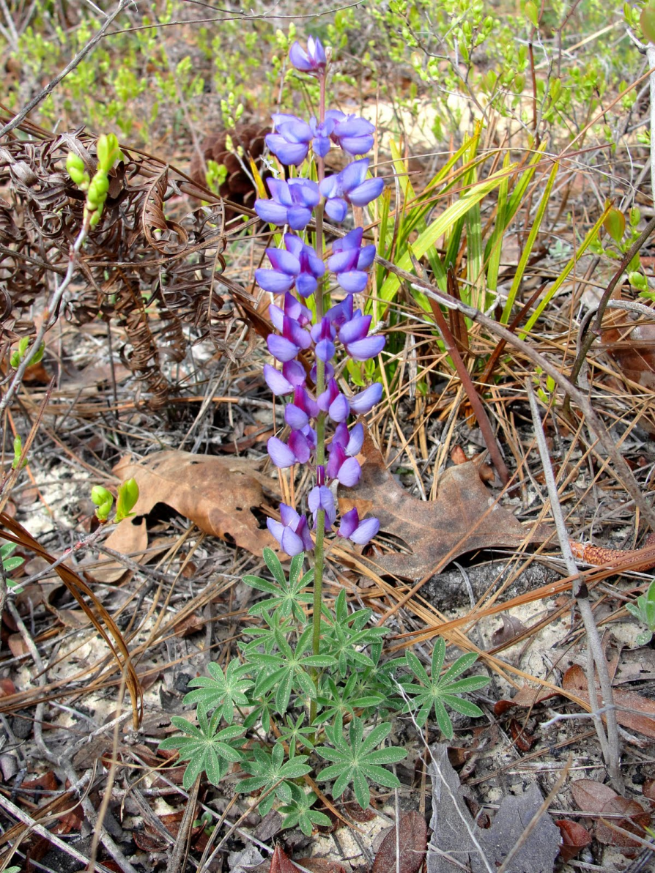
Fabaceae (Leguminosae)
Pea and Legume Family
Peas, Beans, Clover, Alfalfa, Lupine, Vetches

Slide 8
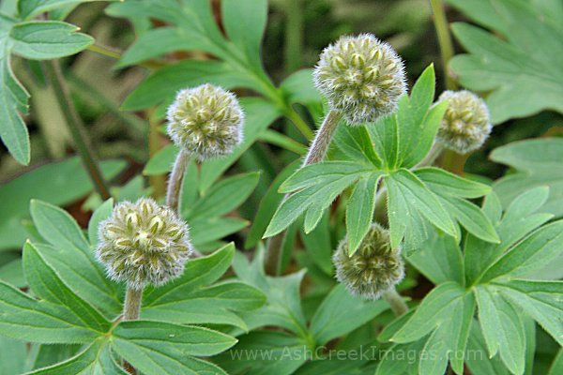
Hydrophyllaceae
Water leaf family
Baby Blue Eyes, Whispering Bells, Scorpionweed

Slide 9
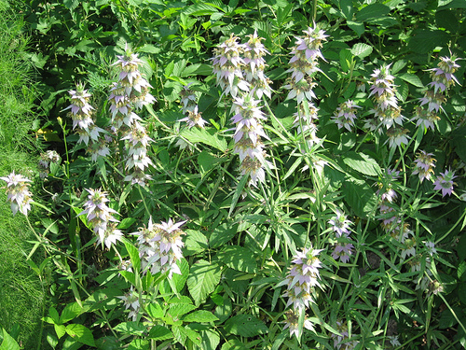
Lamiaceae (Labiatae)
Mint Family
Lemon balm, basal, rosemary, sage, oregano, horse mint

Slide 10
Malvaceae
Mallow Family
Common Mallow or “Cheese Weed”, Hibiscus,

Slide 11
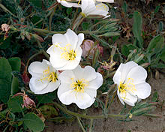
Onagraceae
Evening Primrose Family
Evening Primrose, Fireweed,

Slide 12
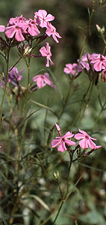
Polemoniaceae
Phlox family
Phlox, Scarlet Gila, Jacob’s Ladder

Slide 13
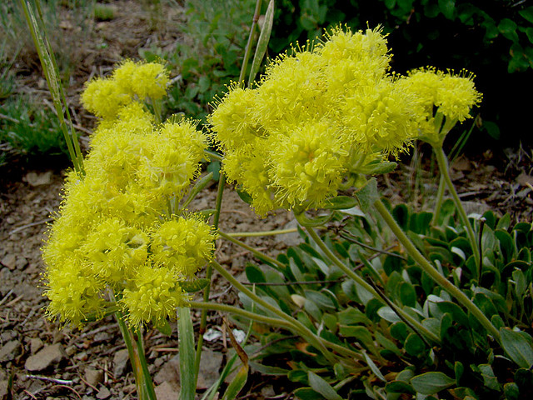
Polygonaceae
Buckwheat family or Knotweed family
Sulphur Buckwheat, Curly Dock,

Slide 14
Ranunculaceae
Buttercup Family
Buttercup, Larkspur, Christmas Rose

Slide 15
Rosaceae
Rose Family
Roses, Strawberries, Plums, Cherries, Peaches and Cotoneaster

Slide 16
Scrophulariaceae
Snapdragon family
Snapdragon, Wolly mulleins, figworts

Slide 17
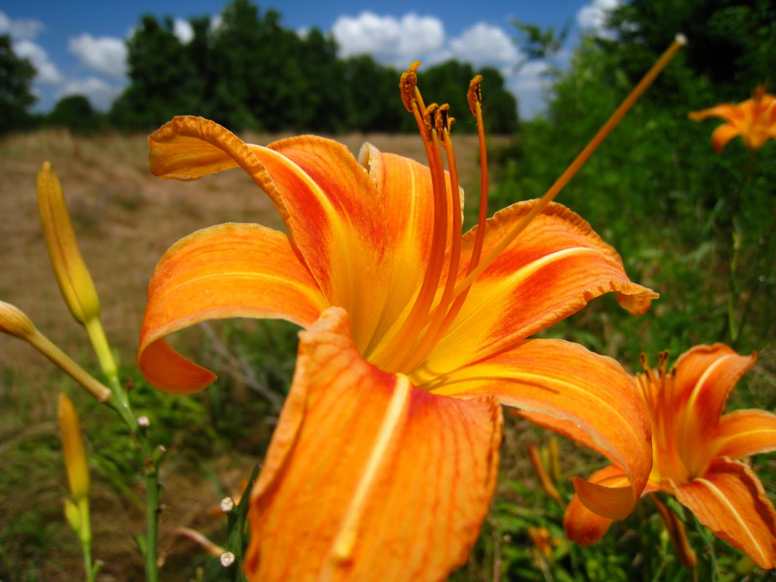
Liliaceae
Lily Family
Lilies, Asparagus, Allium

Slide 18
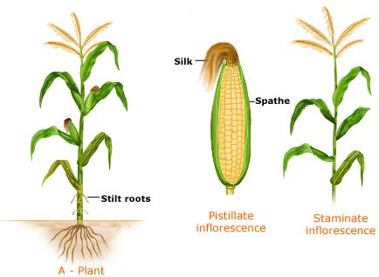
Poaceae
Grass Family
Grasses, Corn, Oats, Bamboo

Slide 19
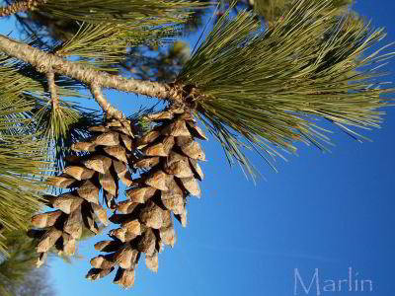
Pinaceae
Pine Family
Pines, Cedars, Firs, and Spruces

Slide 20
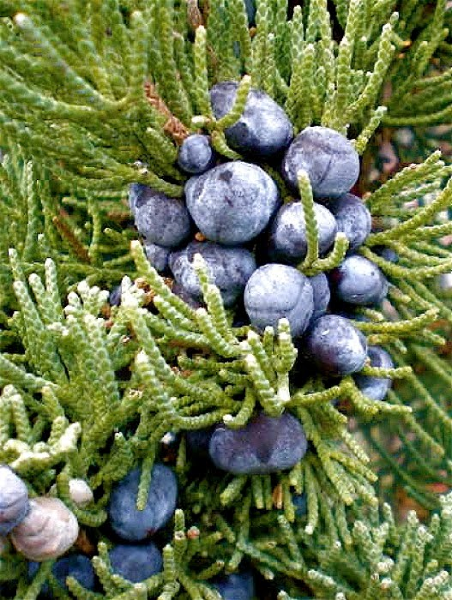
Cupressaceae
Juniper Family
Junipers and Redwoods

Slide 21
Ephedraceae
Ephedra
Mormon Tea, Joint-Pine

