Slide 1
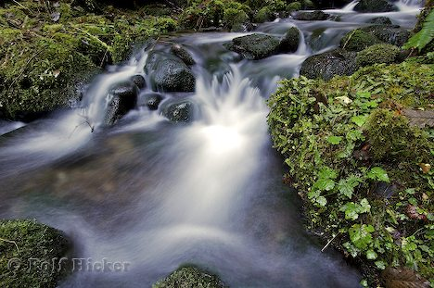
4) Water

Slide 2
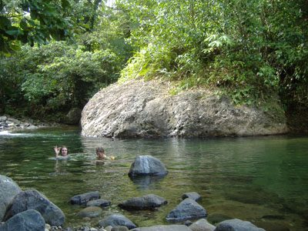
Water
You can last 3-4 days without water
( depending on conditions)
You should drink 3 quarts of water each day.
Boil, filter, or treat water.

Slide 3
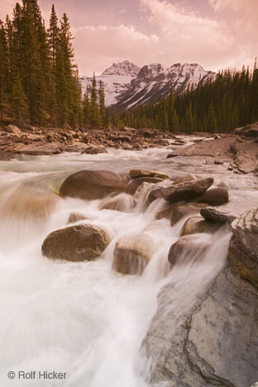

Slide 4
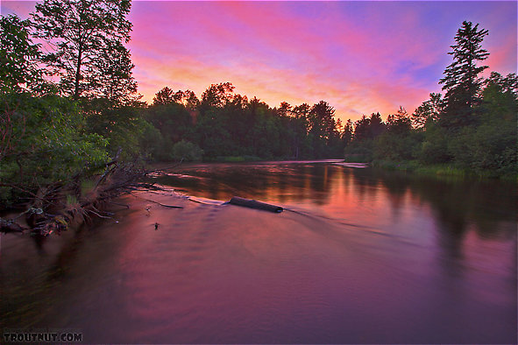
Obtaining Water:
I captured this sunset over one of my favorite holes.

Slide 5
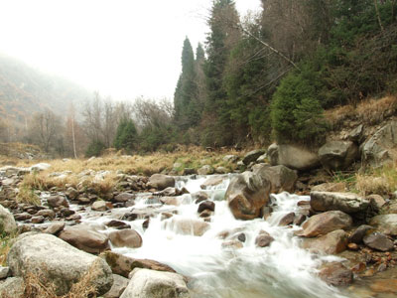

Slide 6
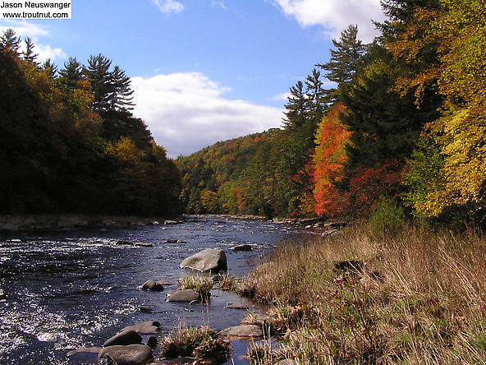
–Surface water (purification required)
This beautiful, remote stretch of one of the lesser-known large Catskill trout streams

Slide 7
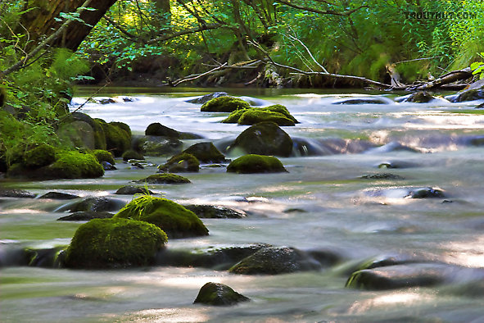
It Might Look good but don’t drink it without purification
This swift little stream is one of my favorites. It harbors an even mix of brook and

Slide 8
–Subsurface (Beach well, dry riverbeds)

Slide 9
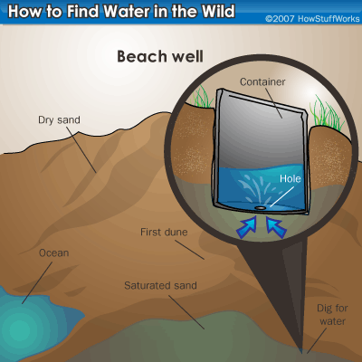

Slide 10
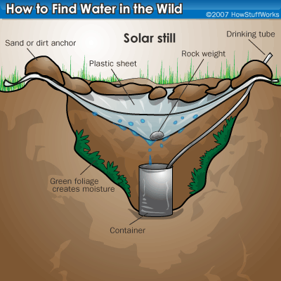

Slide 12
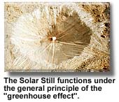
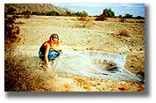
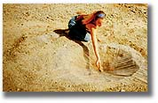
Solar Still

Slide 13
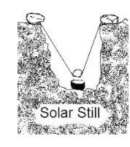
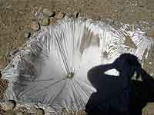
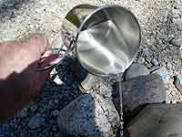
Solar Still

Slide 14
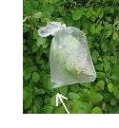
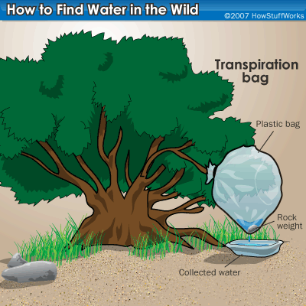
Transpiration bag

Slide 15
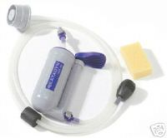
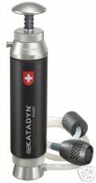
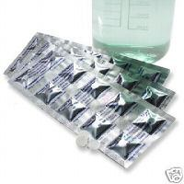
Water Purification Filters

Slide 16
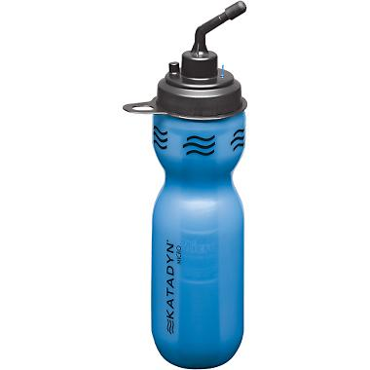
Water purification

Slide 17
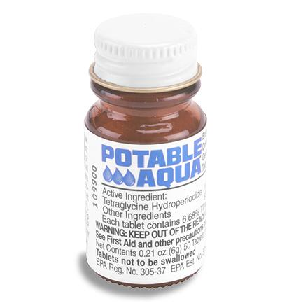
Water Purification Tablets

Slide 18
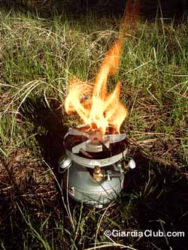
Water Purification boiling

Slide 19
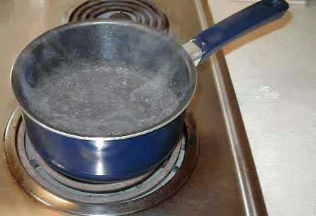
Boiling Water is the Best Method

Slide 20
Correct Water Boiling Time
whole forests have been cut down for firewood in order to boil drinking water
The correct amount of time to boil water is 0 minutes. Thats right, zero minutes.
"According to the Wilderness Medical Society, water temperatures above 160° F (70° C) kill all pathogens within 30 minutes and above 185° F (85° C) within a few minutes. So in the time it takes for the water to reach the boiling point (212° F or 100° C) from 160° F (70° C), all pathogens will be killed, even at high altitude.“
Source: http://www.princeton.edu/~oa/manual/water.shtml

Slide 21
Bleach

Slide 22
Bleach
Typical fresh household chlorine bleach has about 5.35% chlorine content (be sure to read the label). To use household bleach for disinfecting water:
Add two drops of bleach per quart or liter of water.
Stir it well.
Let the mixture stand for a half hour before drinking.
If the water is cloudy with suspended particles:
First filter the water as best you can.
Double the amount of bleach you add to the water

Slide 23
Why Using Bleach to Disinfect Contaminated Water is a Problem
A little known problem with long term storage of bleach in your disaster emergency supply cache is that it degrades over time. A Chlorox bleach released statement
“We recommend storing our bleach at room temperatures. It can be stored for about 6 months at temperatures between 50 and 70 degrees Fahrenheit. After this time, bleach will be begin to degrade at a rate of 20% each year until totally degraded to salt and water. Storing at temperatures much higher than 70 degrees Fahrenheit could cause the bleach to lose its effectiveness and degrade more rapidly.

Slide 24
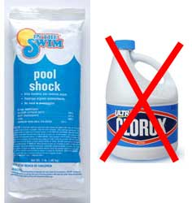
Calcium Hypochlorite to Disinfect Water
calcium hypochlorite - bleach

Slide 25
How to Disinfect Water Using Calcium Hypochlorite
Using granular calcium hypochlorite to disinfect water is a two step process:
To make a stock of chlorine solution (do not drink this!) dissolve 1 heaping teaspoon (about one-quarter of an ounce) of high-test (78%) granular calcium hypochlorite for each two gallons (eight liters) of water.
To disinfect water add one part of the chlorine solution to 100 parts water to be treated.
Let the mixture sit for at least one-half hour before drinking.

Slide 26
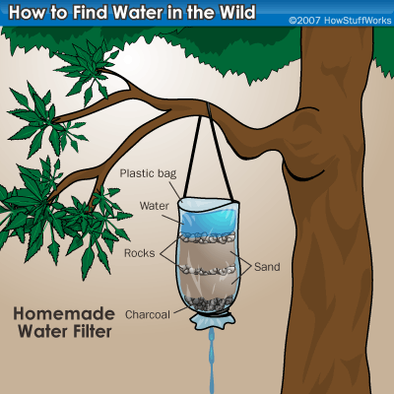
Water filtration

Slide 27
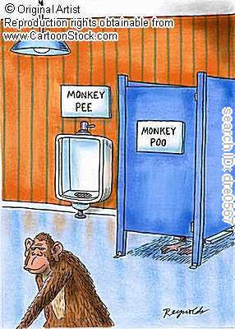
Liquids to avoid
Salt water
Urine
Alcohol

