Slide 1
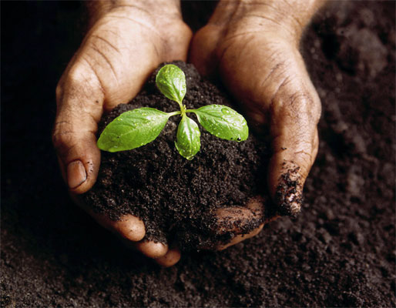
Soil Structure

Slide 2
Soil Profile
Soil Profile - A series of horizontal layers of different chemical composition, physical properties, particle size, and amount of organic matter.
Horizon - Each recognizable layer of the profile.

Slide 3
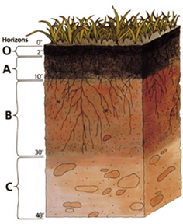
Soil Horizons

Slide 4
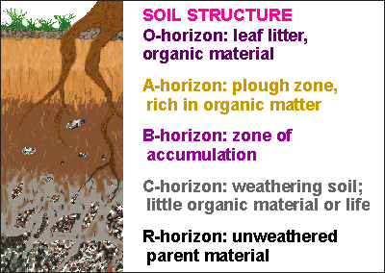
Soil Horizons Defined

Slide 5
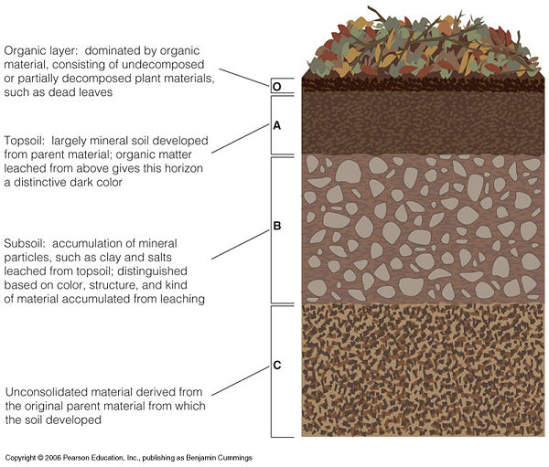

Slide 7
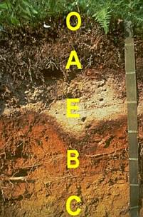
Photo of Soil Horizons

Slide 8
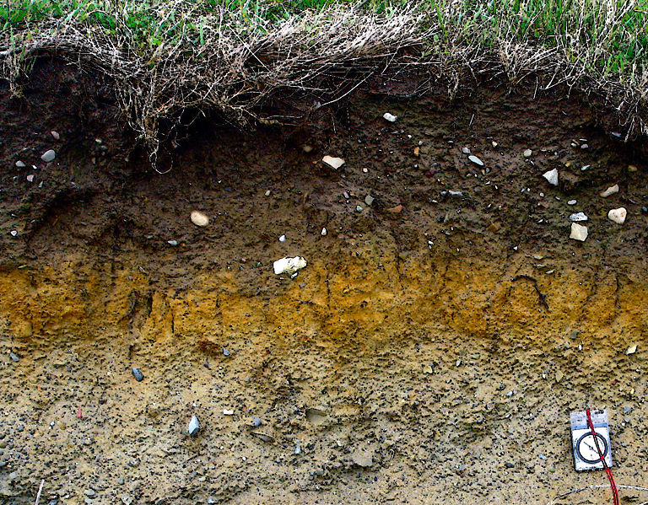

Slide 9
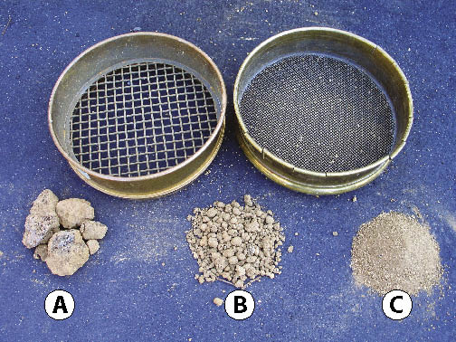

Slide 10
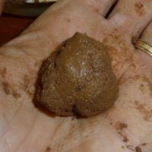
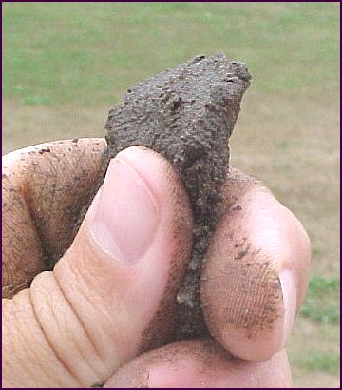
Soil Texture By Feel

Slide 11
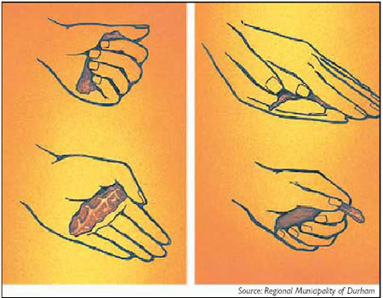

Slide 12
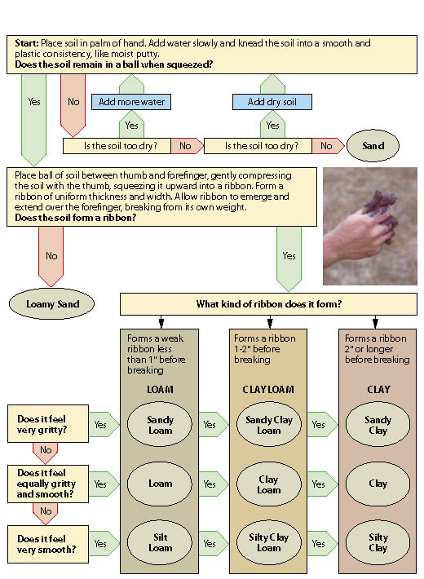

Slide 13
http://www.youtube.com/watch?v=GWZwbVJCNec

Slide 14
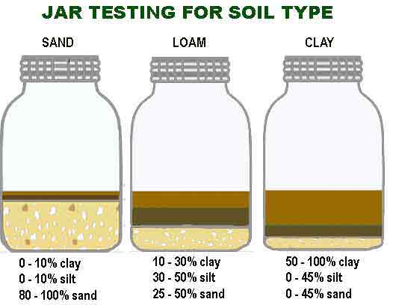

Slide 15
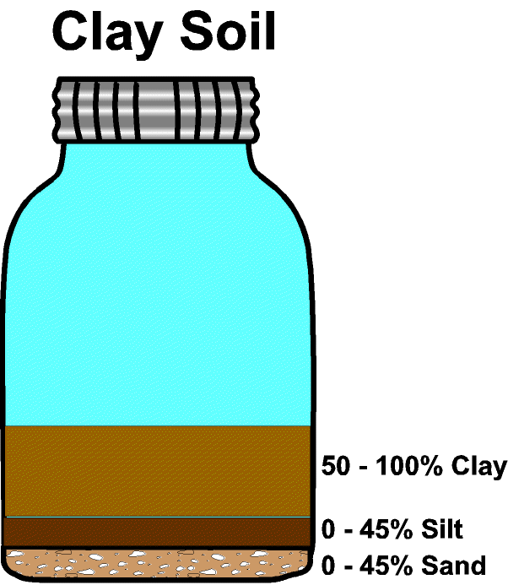

Slide 16
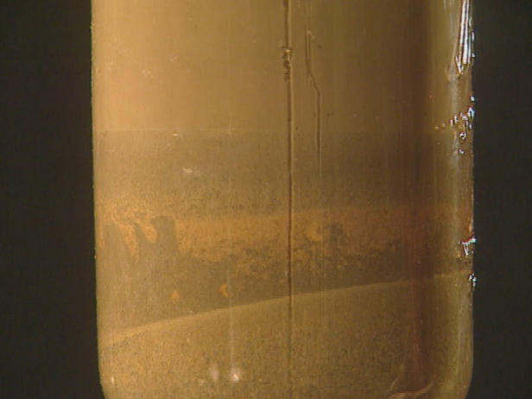

Slide 17
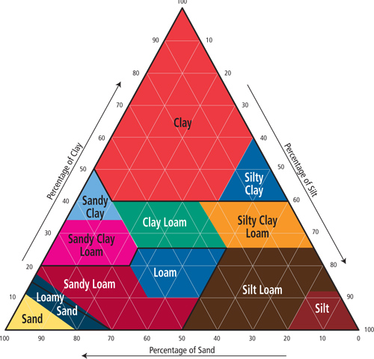

Slide 18
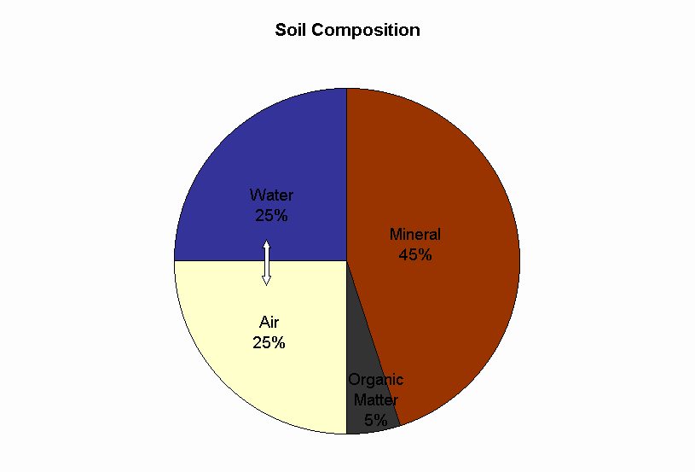

Slide 19
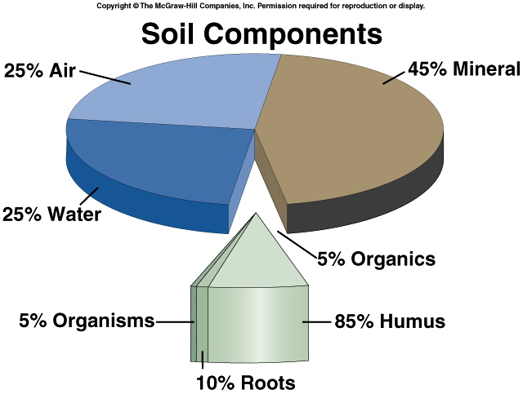

Slide 20
Soil Formation
Humus - Decaying organic material.
Humus becomes mixed with the top layers of rock particles, and supplies some of the needed nutrients to plants.
Humus also creates crumbly soil which allows adequate water absorption and drainage.

Slide 21
Other Factors Influencing Soil Formation:
Earthworms
Burrowing animals
Plant roots
Bacteria and Fungi (decomposers)
Position on slope
Climate
Time
Rainfall
Soil pH

Slide 22
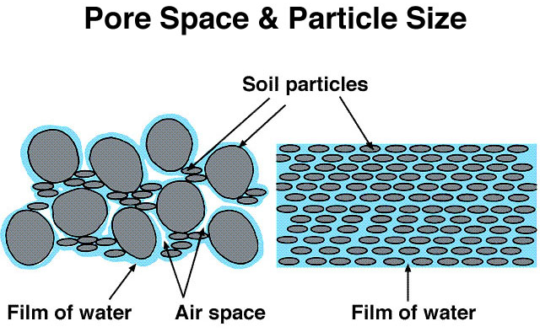
Soil Properties
Texture - Determined by the size of mineral particles within the soil.
Too many large particles leads to extreme leaching.
Too many small particles leads to poor drainage.

Slide 23
Soil Properties
Structure - Refers to the way various soil particles clump together.
In good soils 2/3 of the intra-soil spaces contain air after the excess water has drained.
Protozoa, nematodes, earthworms, insects, algae, bacteria, and fungi are typical inhabitants of soil.

Slide 24
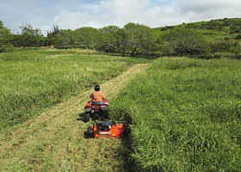
Soil Profiles
Mixtures
Over 15,000 separate soil types have been classified in North America. However, most cultivated land can be classified as either grassland or forest soil.
Grassland Soils - Usually have a deep A Horizon - low rainfall limits topsoil leaching. A Horizon supports most root growth.

Slide 25
Soil Profiles
Forest Soils - Topsoil layer is relatively thin, but topsoil leachate forms a subsoil that supports substantial root growth. (High rainfall areas)
Tropical Rainforests
Two features of great influence:
High temperatures
Rapid decomposition - little litter.
High rainfall
Excessive leaching of nutrients.

Slide 26
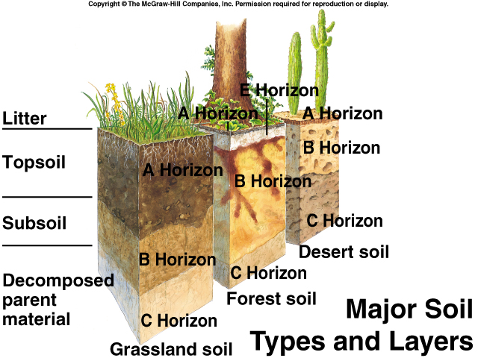

Slide 27
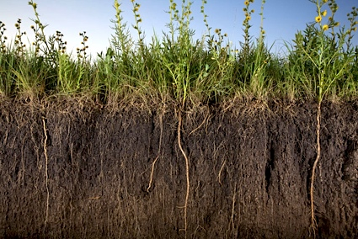
Grassland Soil

Slide 28
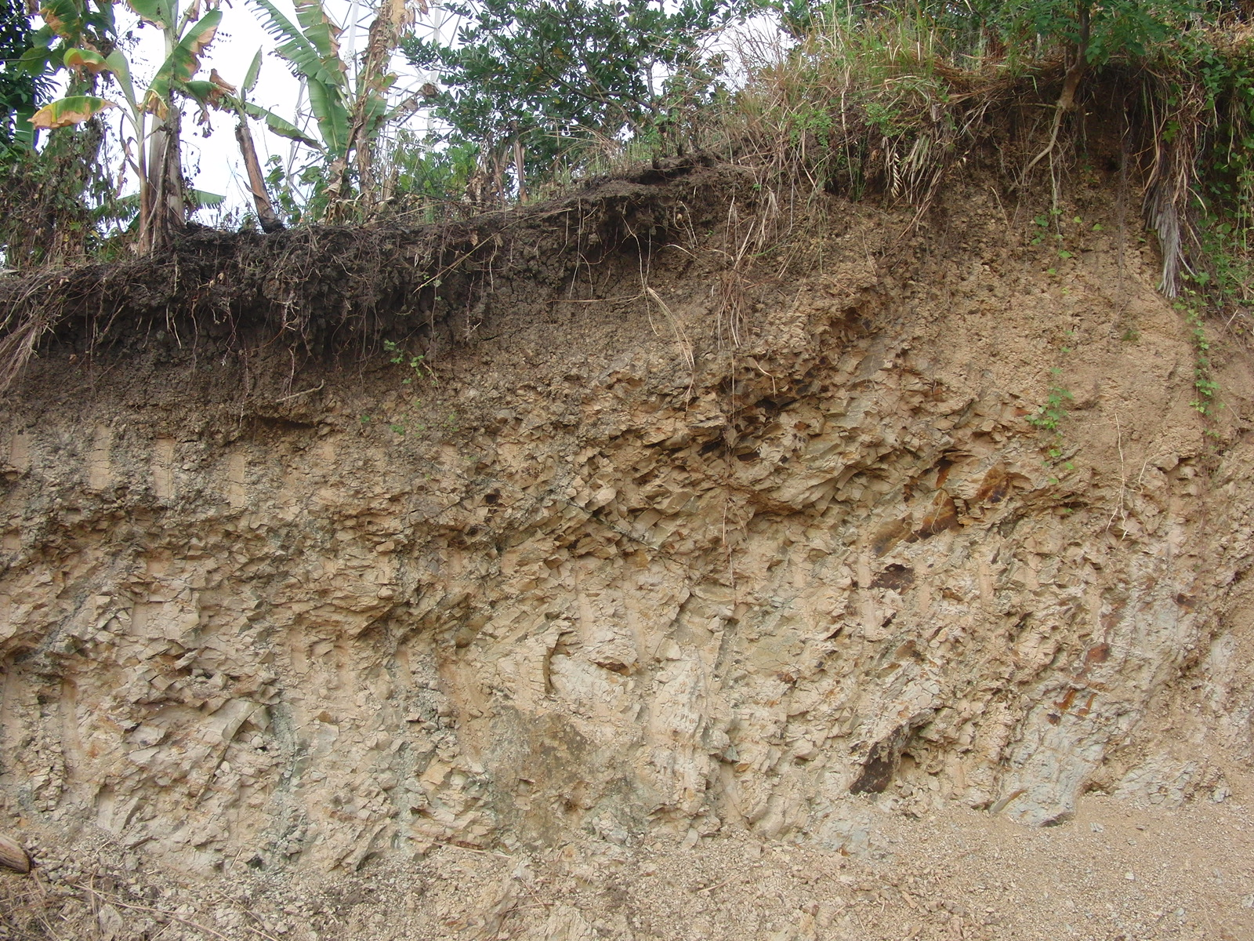
Forest Soil

Slide 29
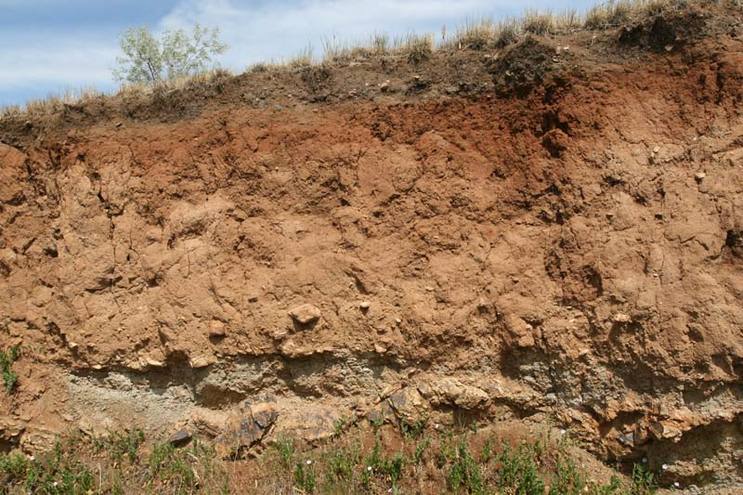
Desert Soil Horizon

Slide 30
Soil Erosion
Erosion - Wearing away and transportation of soil by wind, water, or ice.
Worldwide removes 25.4 Billion tons/yr.
U.S. loses 1% of it’s topsoil / year
Made worse by deforestation and desertification.
Poor agricultural practices increase erosion and lead to the transport of associated fertilizers and pesticides.

Slide 31
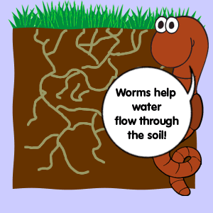

Slide 32
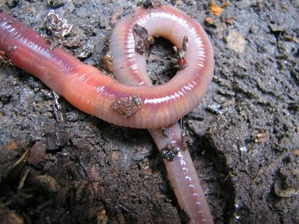
If you feed them, they will come.

Slide 33
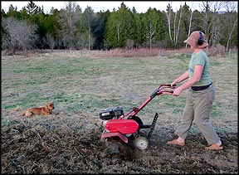
Less harmful than tillage

Slide 34
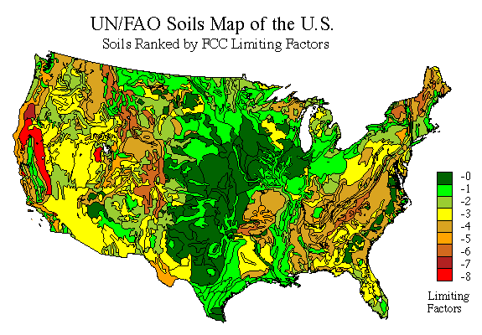

Slide 35
