Slide 1
Weed Control

Slide 6
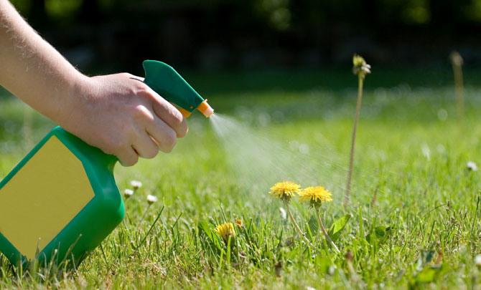
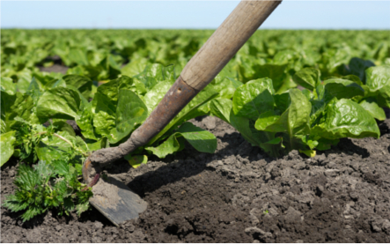

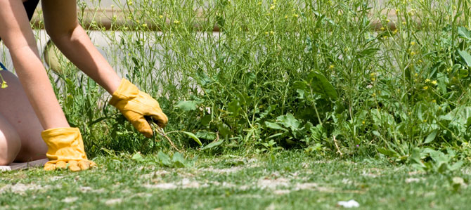

Slide 10
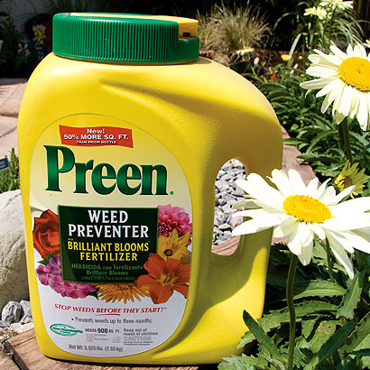

Slide 13

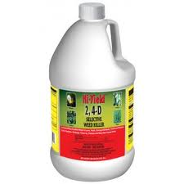

Slide 14

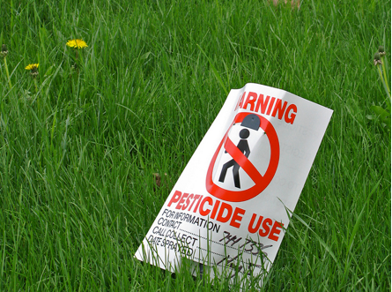

Slide 16
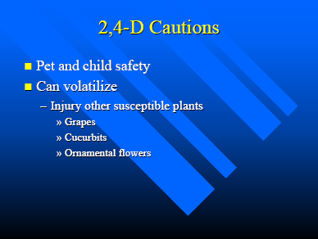

Slide 18
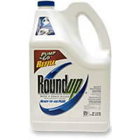

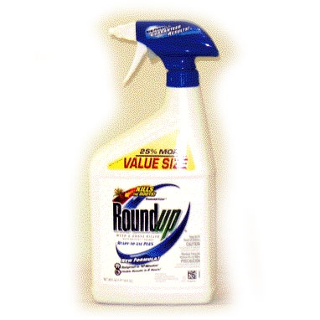

Slide 19
Risks from Glycophosphate
It is claimed that Glycophosphate breaks down into inert parts (water, nitrogen, carbon dioxide, phosphorus and carboxylic acid), which means it should not leave a nasty residue in the soil. However there are warnings about using it near waterways because of it has a harmful effect on aquatic life.

