Slide 1
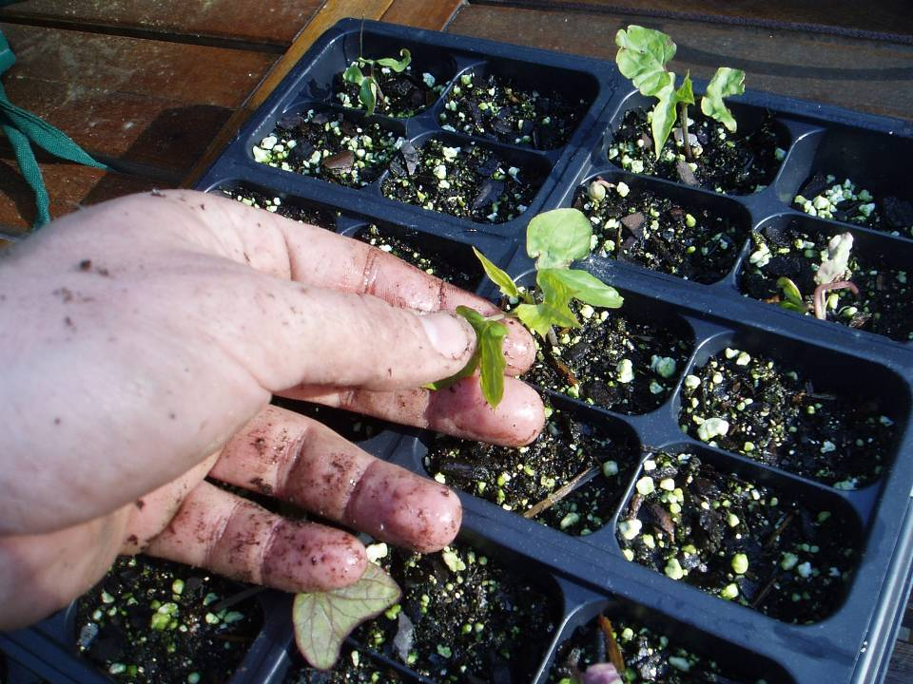
Starting
Acclimation

Slide 2
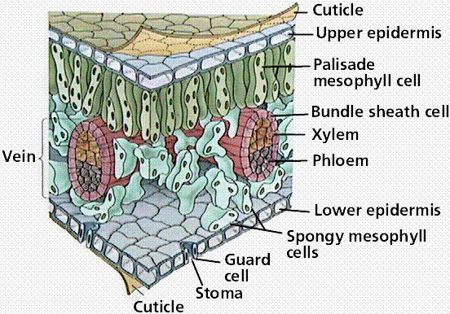
Starting
Acclimation
  Plants must develop cuticle
  Gradual exposure to “harsh” climates
  Dry conditions, wind, light intensity, etc.

Slide 3
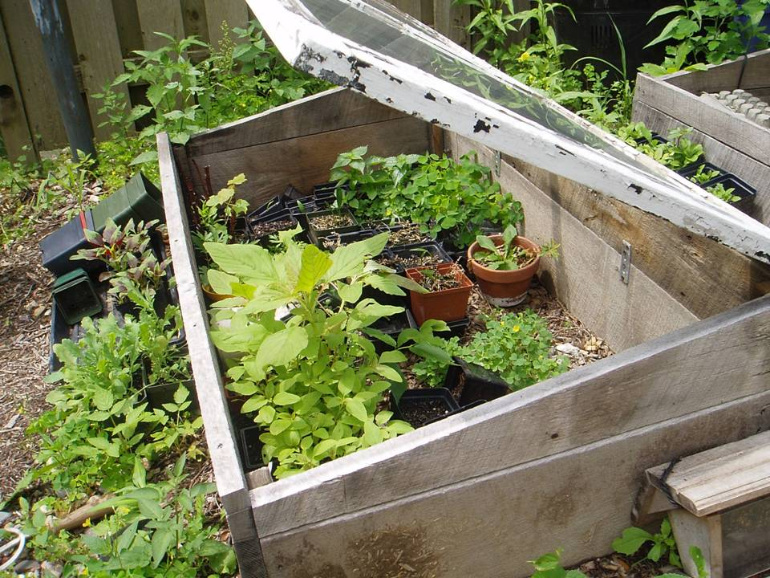

Slide 4
Starting
Direct sowing
  Avoids transplant shock
  Less work
  More risk with weather, pests, disease, erosion

Slide 5
Starting
Direct sowing
  Know conditions and requirements for seeds
    Warm- or cool-season crop
    Average last frost date

Slide 6
Starting
Direct sowing
  Sow or broadcast into a well-raked bed
  Free of stones or large debris
  Cover with a fine layer of soil
  Gently water to avoid erosion

Slide 7
Storing / Collecting
Storing
  Keep dry
  Place in airtight container
  Label and date
  Store in 40º F, low humidity

Slide 8
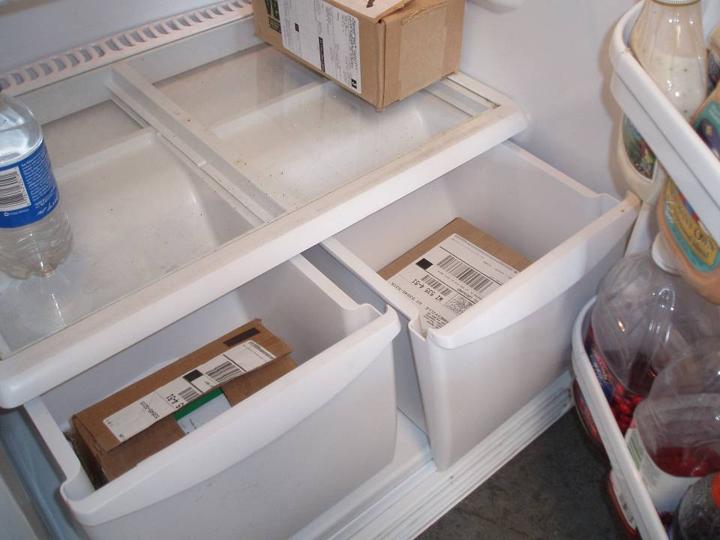

Slide 9
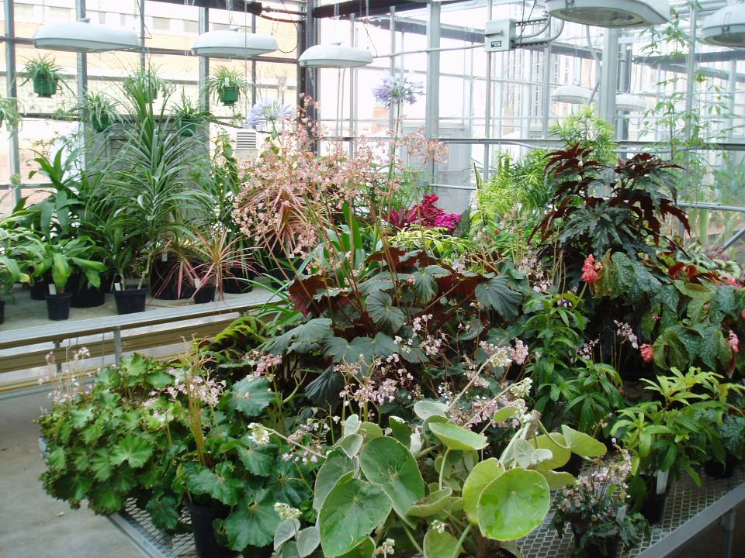
Asexual Propagation

Slide 10
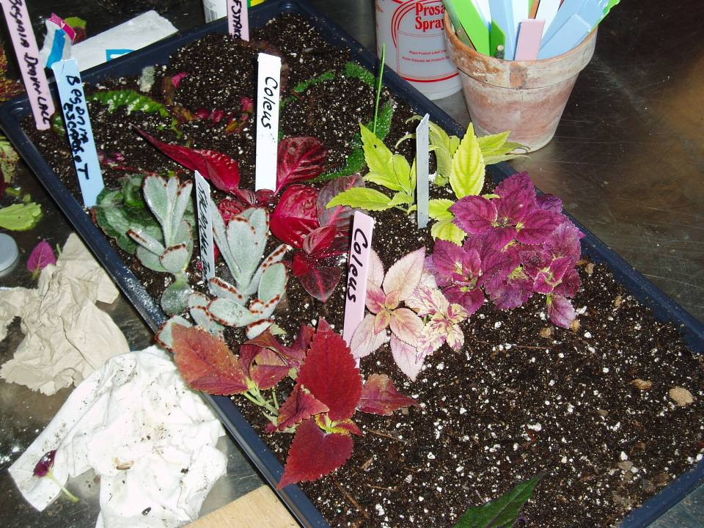

Slide 11
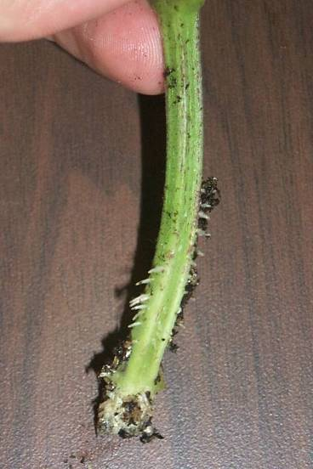
Totipotency
Totipotent: each plant cell possess the necessary genetic information to produce a new plant organ.

Slide 12
Types of Asexual Propagation
Divisions
Cuttings
Layers
Grafting
Tissue Culture

Slide 13
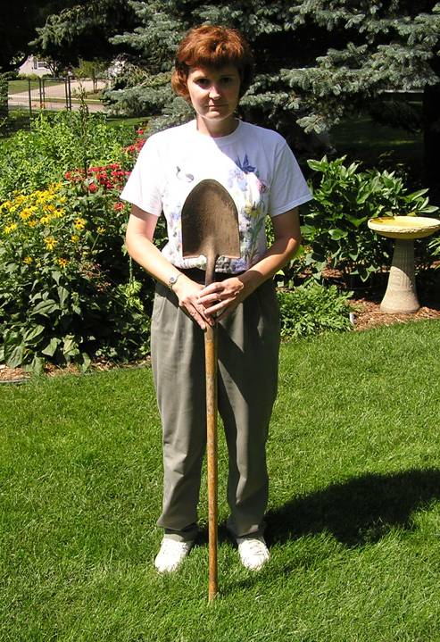
Dividing Plants
  Division of a mass of plants
    Spring blooming plants, divide in fall
    Late summer blooming plants, divide in spring

Slide 14
Separation
Remove loose soil
Remove dead leaves and stems
Note root system of plant
  Spreading
  Clumping
  Rhizome
  Tuber
Notes:
Shake or hose off loose soil and remove dead leaves and stems. This will help loosen tangled root balls and make it easier to see what you are doing.
Perennials have several different types of root systems. Each of these needs to be treated a bit differently.

Slide 15
Separation
Spreading root systems
Many slender roots from center of plant
Plants can be invasive
Cut with shears or pulled apart by hand
Asters, bee balm, lamb’s ear, purple coneflower, many common perennials
Notes:
Spreading root systems have many slender matted roots that originate from many locations with no distinct pattern. Plants with spreading root systems include asters, bee balm, lamb’s ear, purple cornflowers and many other common perennials. These can crowd out their own centers. Some can be invasive unless divided frequently. They can usually can be pulled apart by hand, or cut apart with shears or knife.
Large, vigorous plants with thickly intertwined roots may need forceful separation with digging forks. Put two forks back to back in the center of the plant and use them to pry the pieces apart.
Divide the plants into clumps of three to five vigorous shoots each. Small or weak and woody divisions should be discarded. Discard the center of the clump if it is weaker than the outside edges.

Slide 16
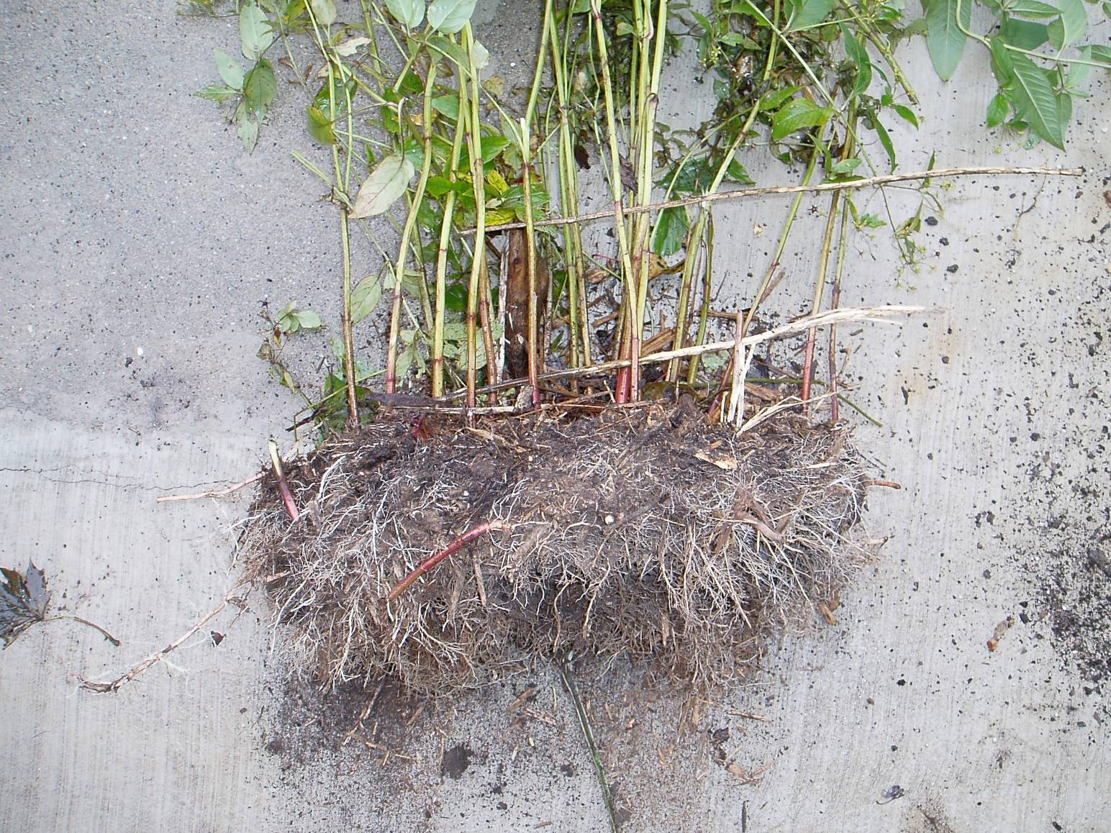

Slide 17
Separation
Clumping root systems
Many fleshy roots from crown of plant
Can crowd own centers
Keep one bud/eye with each division
Astilbes, hostas, daylilies, orn. Grasses
Notes:
CLUMPING ROOT SYSTEMS originate from a central clump with multiple growing points. Many have thick fleshy roots. This group includes astilbes, hostas, daylilies and many ornamental grasses.
It is often necessary to cut through the thick fleshy crowns (the central growing area between the roots and the leaves and stems of the plant) with a heavy, sharp knife. You can also pry apart these roots with back to back digging forks.
Keep at least one developing eye or bud with each division. If larger plants are wanted, keep several eyes.

Slide 18
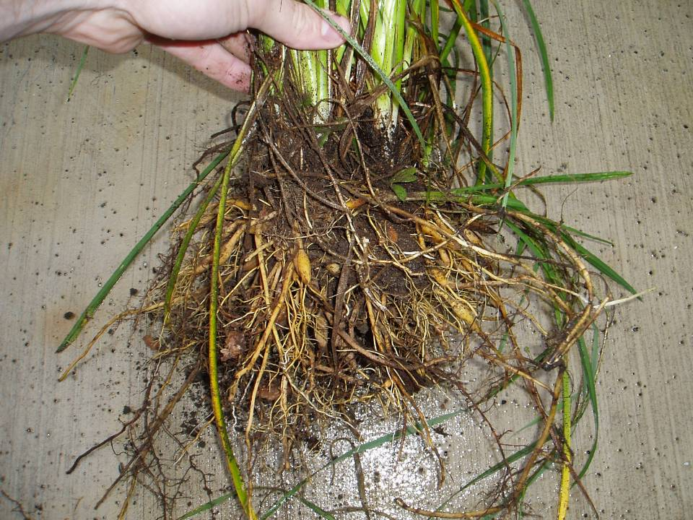

Slide 19
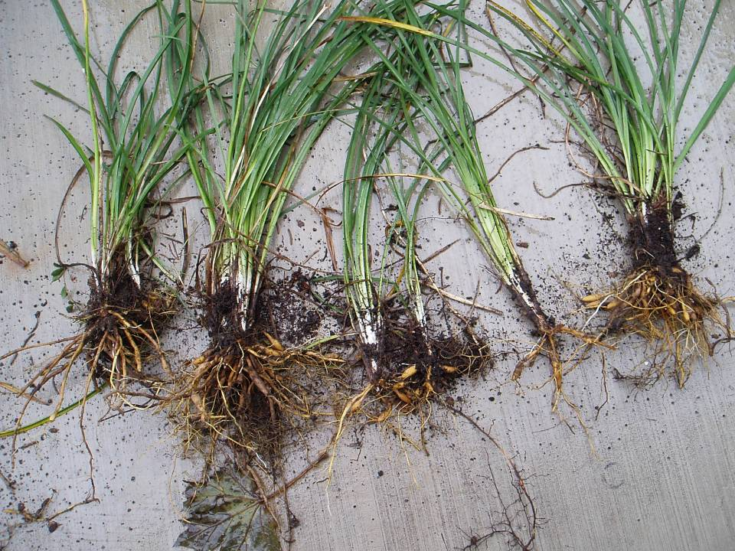

Slide 20
Separation
Rhizome division
‘Horizontal stems’, Primarily bearded iris
Divide after flowering through fall
Cut and discard rhizome sections > 1 year
Inspect for disease and insect damage
Cut back leaves to ‘fans’
Replant with top of rhizome above soil level
Notes:
Rhizomes are stems that grow horizontally at or above the soil level. Bearded irises are the most common perennial with this type of root system. Divide irises any time between a month after flowering until early fall.
Cut and discard the rhizome sections that are one year or older. Also, inspect rhizomes for disease and insect damage. Damaged rhizomes should be trimmed and treated, or discarded if too badly damaged.
Iris divisions should retain a few inches of rhizome and one fan of leaves, trimmed back halfway. Replant with the top of the rhizome just showing above soil level.

Slide 21
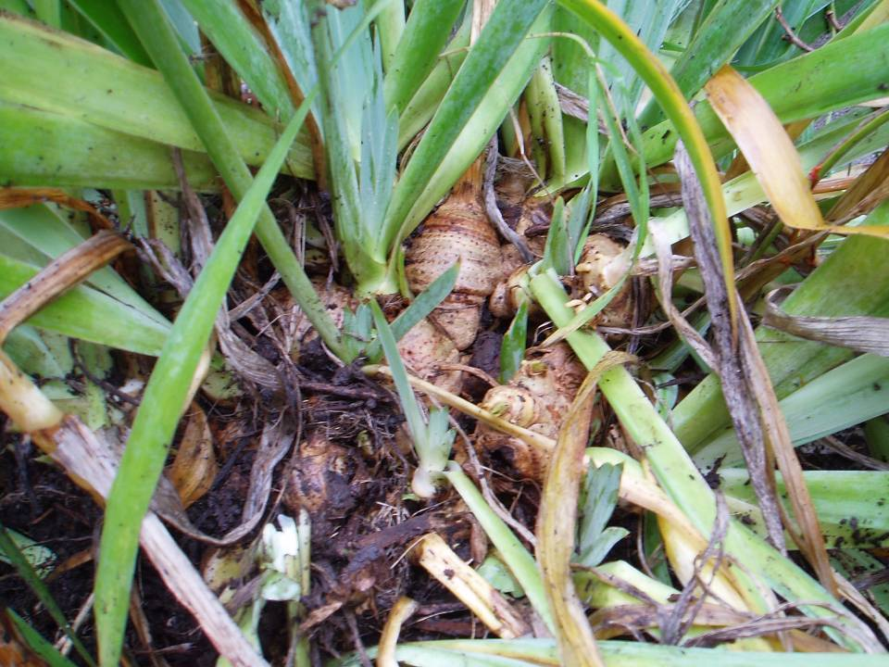

Slide 22
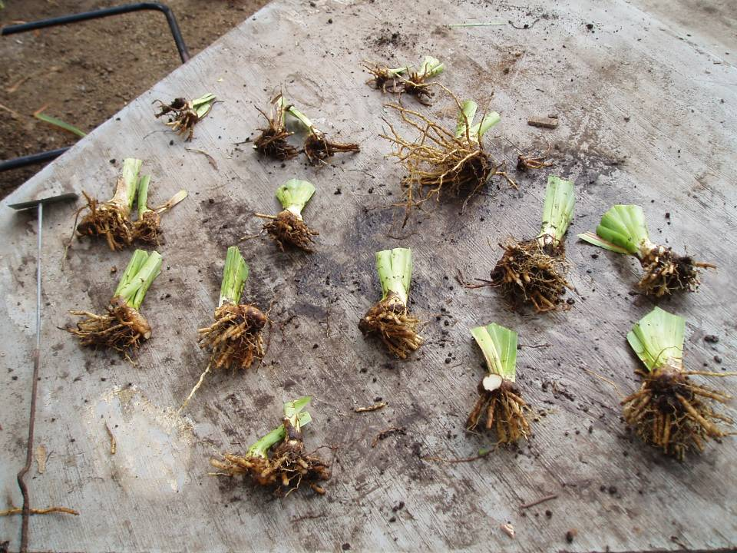

Slide 23
Separation
Tuberous roots
Enlarged roots for storage
Divide with sharp knife
Each root must contain stem tissue and bud
Can be replanted or stored
Dahlias
Notes:
TUBEROUS ROOTS
Dahlias are an example of perennials with tuberous roots. The tubers should be cut apart with a sharp knife. Every division must have a piece of the original stem and a growth bud attached. After division they can either be replanted or stored for spring planting.

Slide 24
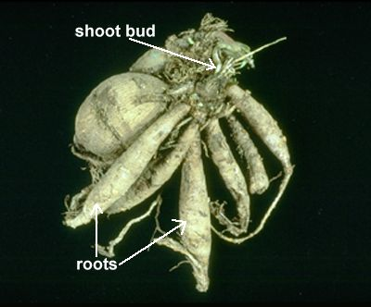
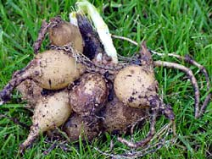

Slide 25
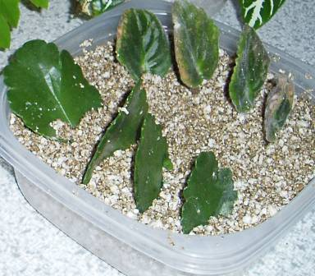
Cuttings
Vegetative plant part which is severed from the parent plant in order to regenerate itself, thereby forming a whole new plant
Leaves, stems, roots

Slide 26
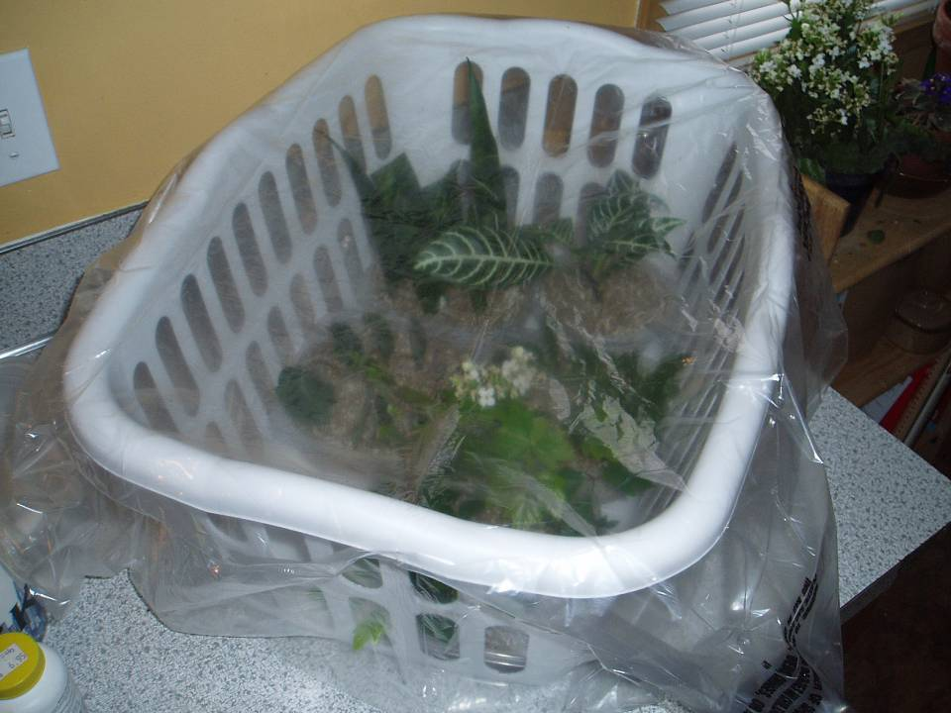

Slide 27
Cuttings
Herbaceous: succulent, soft materials (green)
Softwood: soft, succulent growth of woody plants
Semi-Hardwood: partially mature wood of the current season’s growth
Hardwood: dormant, mature stems

Slide 28
Cuttings: Shoot
Terminal Bud
Axillary Bud
Stem
Leaf
Adventitious Roots

Slide 29
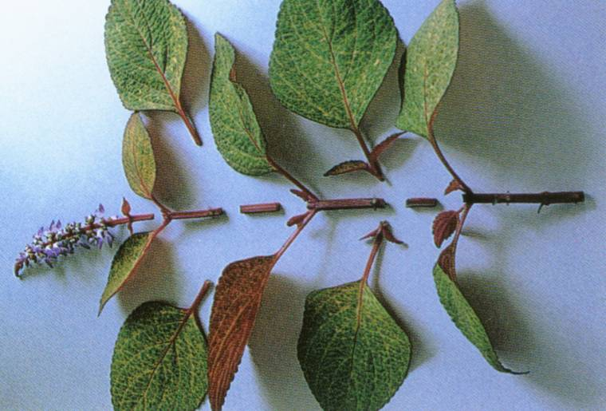
Cuttings

Slide 30
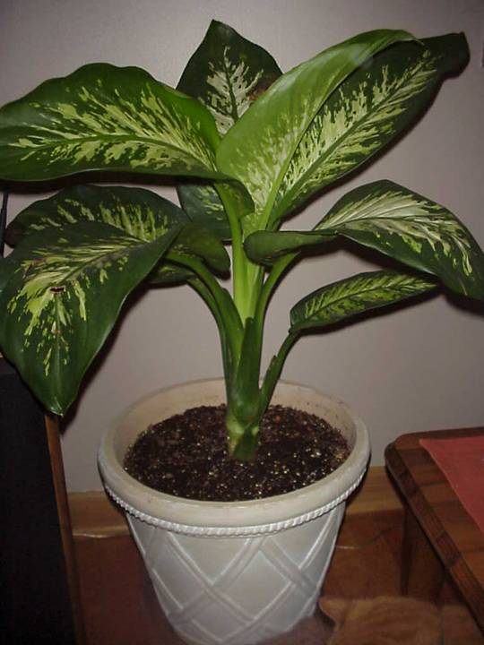
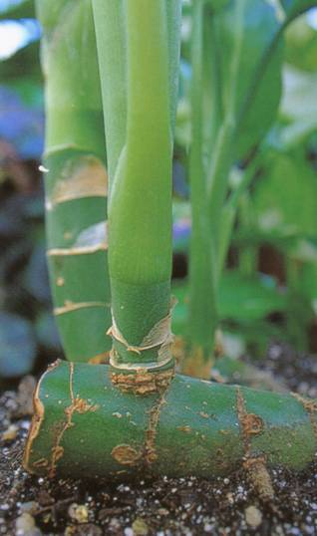
Cane/Shoot Cutting
  Leaves
  Stems
  Buds

Slide 31
Cuttings: Leaf
Terminal Bud
New bud
Axillary Bud
Stem
Leaf

Slide 32
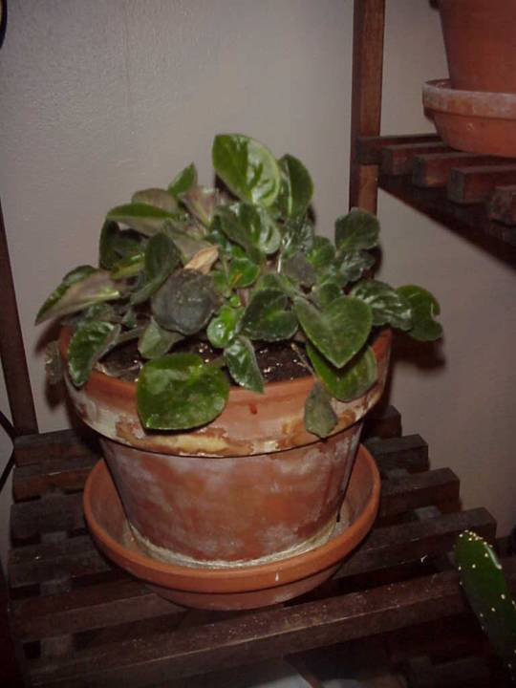
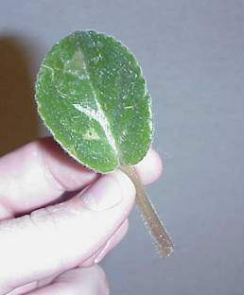
Leaf Cutting
  Leaf only

Slide 33
Cuttings: Leaf

Slide 34
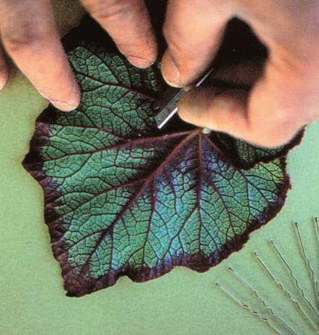
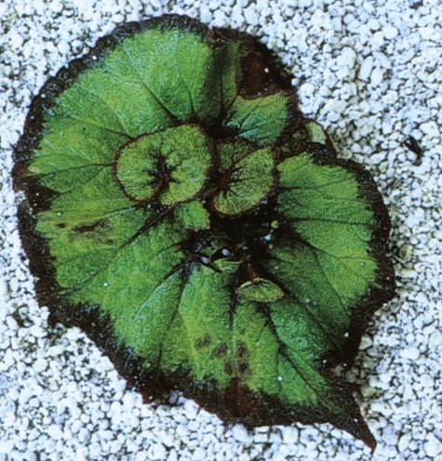

Slide 35
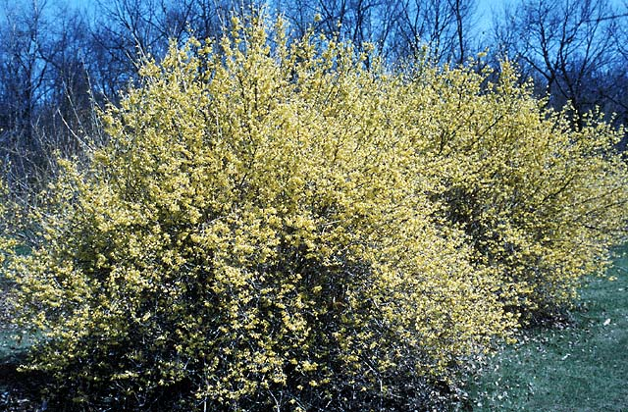
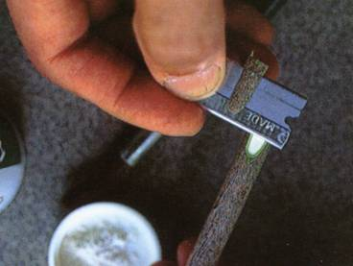
Cuttings: Hardwood

Slide 36
Cuttings: Hardwood
Cut end of branch
Cambium exposed

Slide 37
Layering
Stems still attached to their parent plant may form roots where they touch a rooting medium
Severed from the parent plant, the rooted plant becomes a new plant

Slide 38
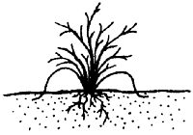
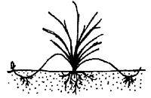

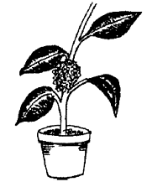
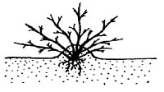
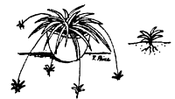
Layering Methods
Tip Layer
Simple Layer
Compound Layer
Stooling
Air Layer
Stolons

Slide 39
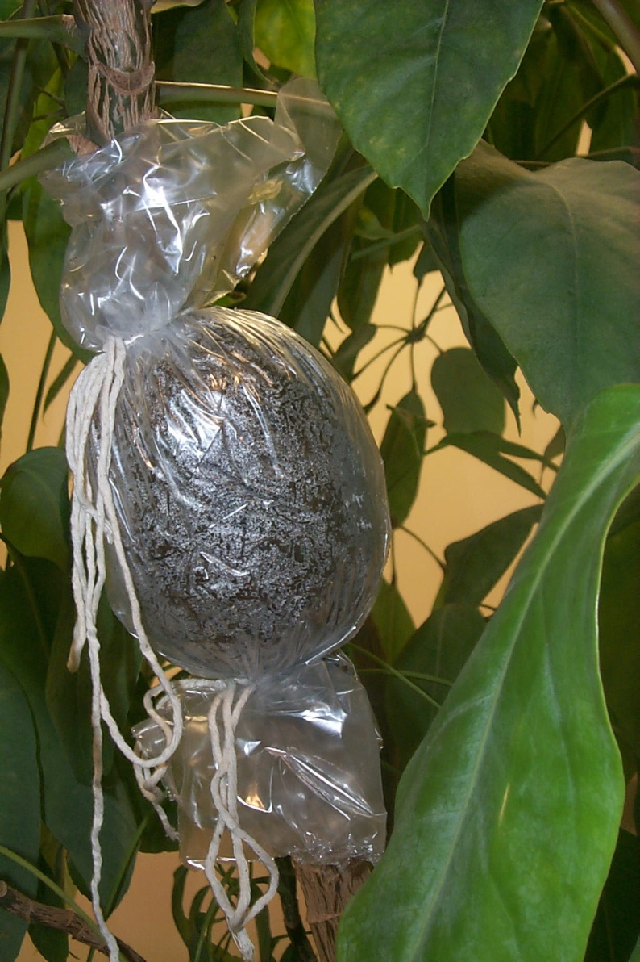
Air Layer
Useful procedure on leggy plants
Wound stem and cover with moist medium to induce rooting

Slide 40
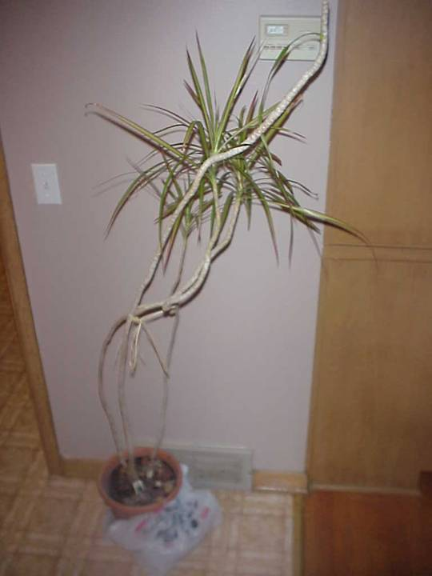

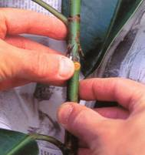
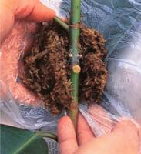

Slide 41
Grafting/Budding
Method that joins plant parts so they will grow as one plant
Used to propagate cultivars that will not root well as cuttings or whose own root systems are inadequate
Induce growth form (dwarfing)

Slide 42
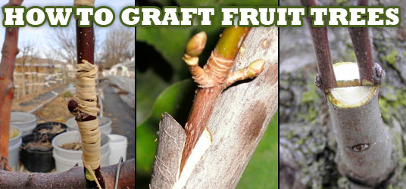

Slide 43
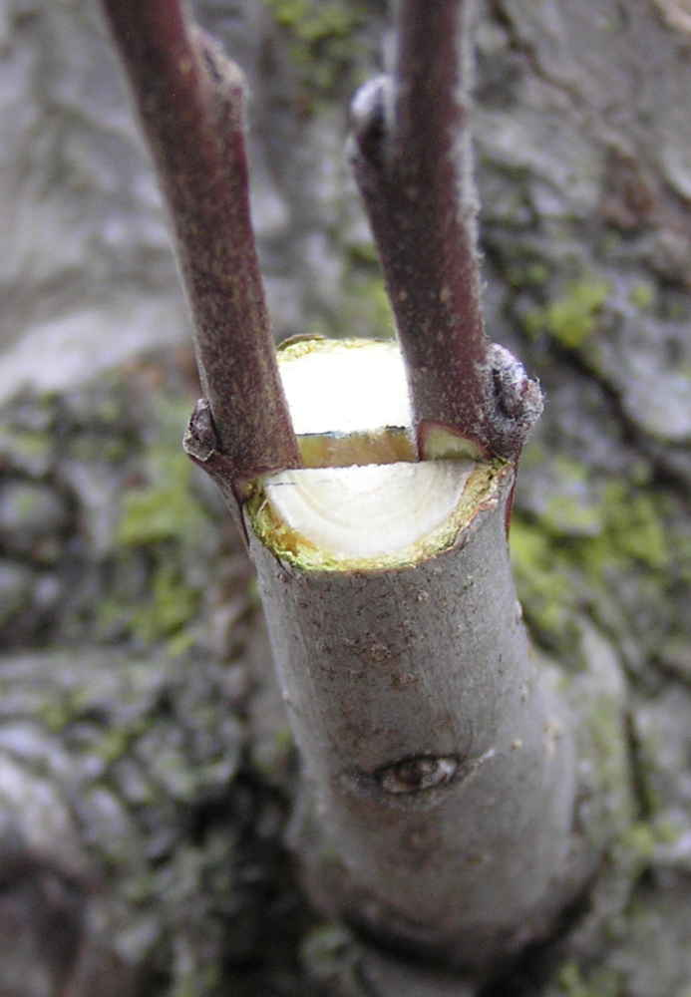
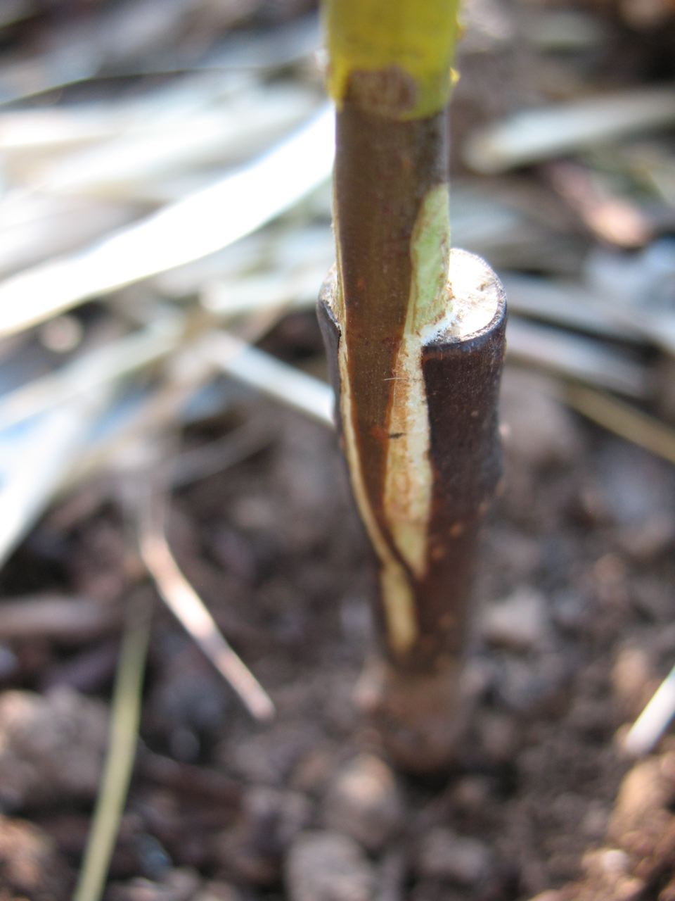

Slide 44
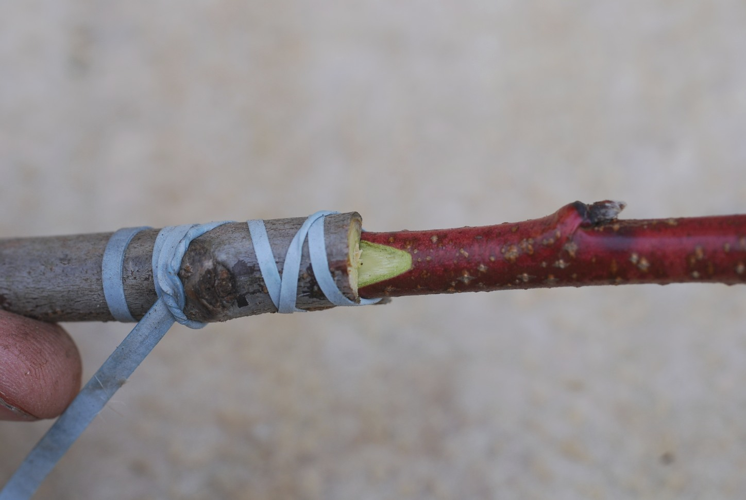

Slide 45
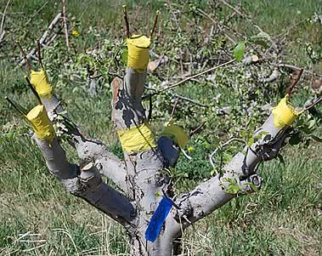

Slide 46
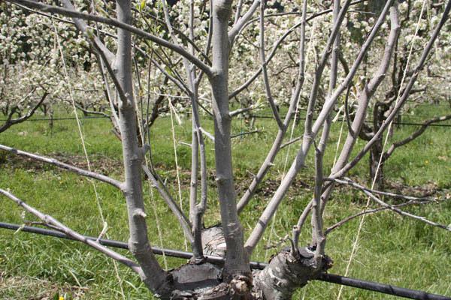

Slide 47
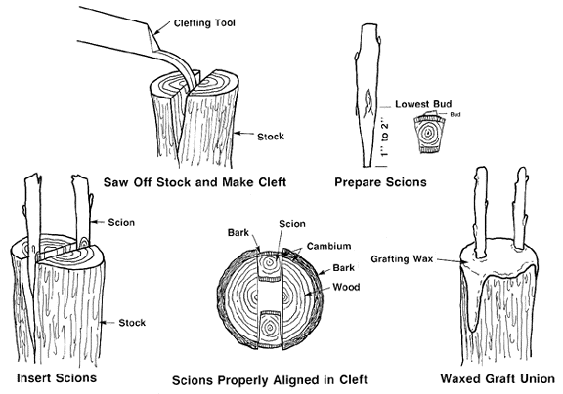

Slide 48
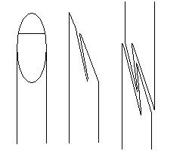

Slide 49
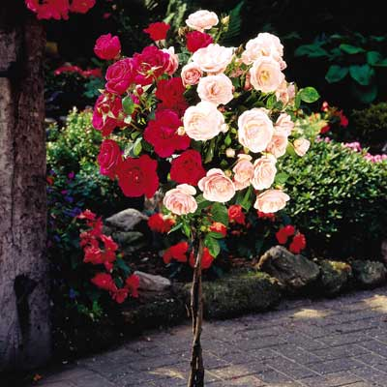

Slide 50
