Slide 1
pH and Concentrations

Slide 2
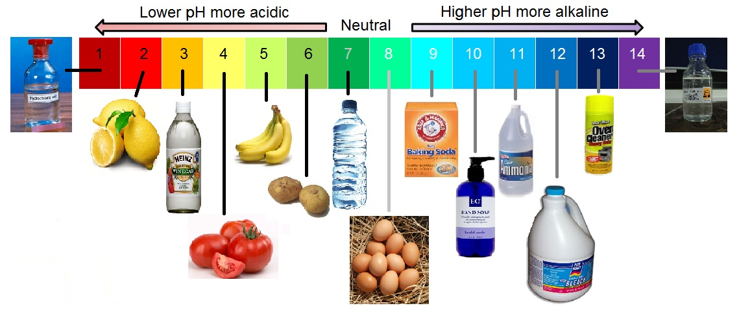

Slide 3
pH is a measure of the [H₃O ⁺] in solution.

Slide 4
Water Ionizes according to the equation:
2H₂O ⬅➔ H₃O⁺ + OH⁻

Slide 5
The equilibrium expression for the reaction would be:
K_{eq} = [H₃O⁺] [OH ⁻] / [H₂O]²

Slide 6
Experimental evidence indicates that pure water contains 1 X 10 ⁻⁷ mole of both H₃O⁺ and OH ⁻

Slide 7
The concentration of water in pure water is calculated as 55.6 moles/dm³

Slide 8
This information allows us to get an expression: K_{sp}(55.6)² = [H₃O⁺] [OH ⁻] = 1 X 10 ⁻¹⁴

Slide 9
K_{sp}(55.6)² becomes a new constant, the
ion product constant of water, K _{w}

Slide 10
The expression becomes
K _{w} = [H₃O⁺] [OH ⁻] = 1 X 10 ⁻¹⁴

Slide 11
K _{w} is a constant for all dilute aqueous solutions at room temperature.
Although the [H₃O⁺] and [OH ⁻] may change, the product is always 1 X 10 ⁻¹⁴
This provides the basis for the pH scale.

Slide 12
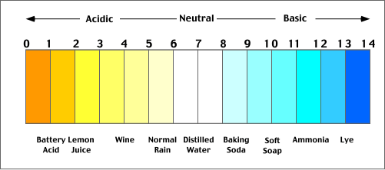

Slide 13
Calculating pH:
The equation is: pH = - log [H₃O⁺]
[H₃O⁺] is expressed in powers of 10 from 10 ⁻¹⁴ to 10 ⁰
If [H₃O⁺] = 1 X 10 ⁻⁷, the negative log of [H₃O⁺] = 7. The pH equals 7, indicating a neutral solution.
The calculation of pH always gives a number between 0 and 14.

Slide 14
Practice Problem Set #1:
1. What is the pH of a solution whose [H₃O⁺] is 1 X 10⁻⁵ M?
2. What is the [H₃O⁺] concentration of a solution with a pH of 9?
3. What is the pH of a solution whose [H₃O⁺] concentration is 3 X 10⁻³ M?
4. What is the pH of a solution with a [H₃O⁺] concentration of 1 X 10⁻¹² M?
5. What is the [H₃O⁺] concentration of a solution whose pH is 8.9?

Slide 15
pOH
pOH is a measure of the [OH ⁻] in solution.

Slide 16
Calculating pOH:
The equation is: pOH = - log [OH ⁻]
[OH ⁻] is expressed in powers of 10 from 10 ⁻¹⁴ to 10 ⁰
[H₃O⁺] [OH ⁻] = 1 X 10 ⁻¹⁴
pH + pOH = 14

Slide 17
Calculate the pOH if the pH of a solution is 2.46
pH + pOH = 14
pOH = 14 - 2.46
pOH = 11.54

