Slide 1
Hydrates
A substance that contains water
A substance that water attaches to

Slide 3
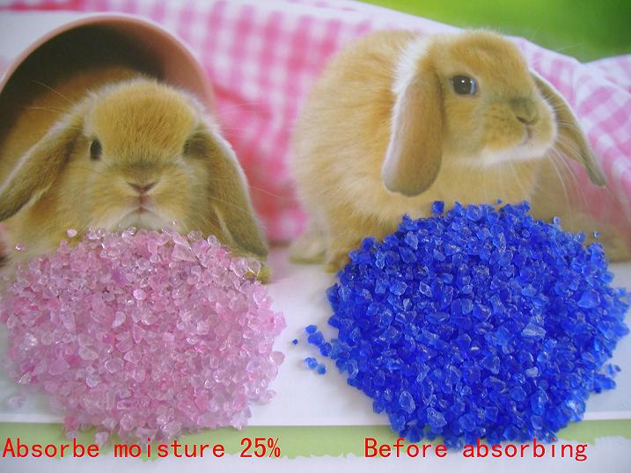

Slide 4
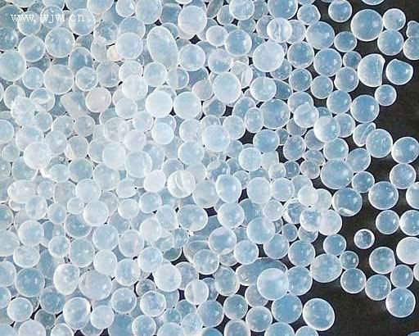
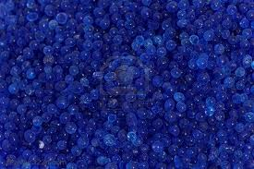
Silica Gel

Slide 5
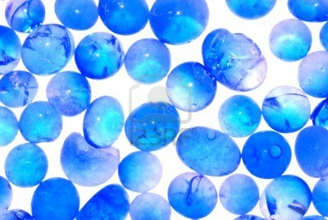

Slide 6
Hydrates are compounds that attract and bond with water molecules when they crystallize. The two parts of a hydrate are the anhydrous salt and the water of hydration. The ratio of these water molecules in the compound is always a whole number.

Slide 7
Naming Hydrates
A sample hydrate formula is written as follows:
CuSO4•5H2O.
CuSO4 is the anhydrous salt and 5H2O is the water of hydration.

Slide 8
Example: Name CuSO4•5H2O
1. Name the salt. CuSO4 is copper(II) sulfate
2. Determine the prefix to be used based on the number of water molecules. The list of prefixes used in naming hydrates are listed in a chart below. There are 5 water molecules, so you should use the prefix penta-. copper(II) sulfate penta-
3. Add the word "hydrate" to the end of the prefix. copper(II) sulfate pentahydrate

Slide 9
The prefixes used for naming hydrates are as follows:
Prefix | Moles of Water | Name | Formula
mono- | 1 | monohydrate | XY•H2O
di- | 2 | dihydrate | XY•2H2O
tri- | 3 | trihydrate | XY•3H2O
tetra- | 4 | tetrahydrate | XY•4H2O
penta- | 5 | pentahydrate | XY•5H2O
hexa- | 6 | hexahydrate | XY•6H2O
hepta- | 7 | heptahydrate | XY•7H2O
octa- | 8 | octahydrate | XY•8H2O
nona- | 9 | nonahydrate | XY•9H2O
deca- | 10 | decahydrate | XY•10H2O

Slide 10
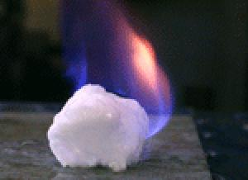

Slide 11
Short Hydrates Video
http://www.youtube.com/watch?v=Np_SDsezVXo

