Slide 1
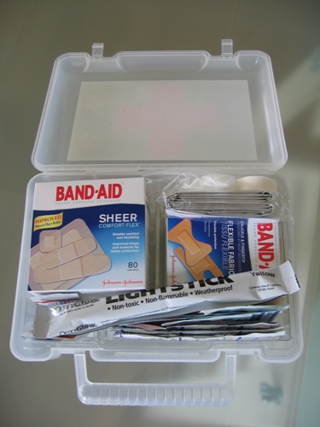
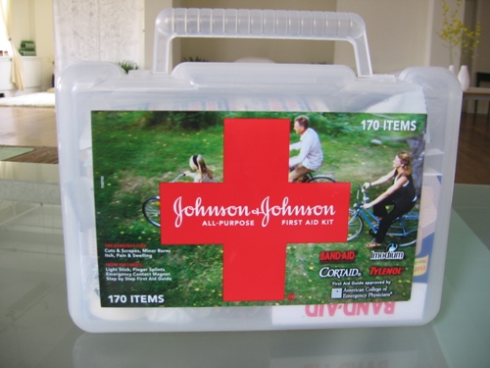
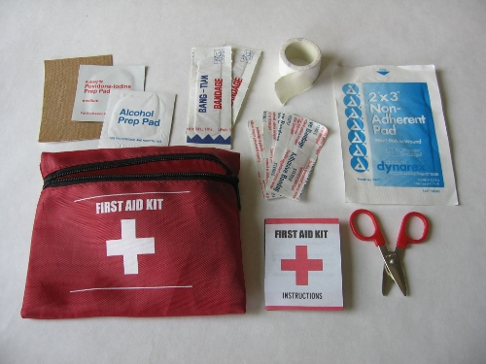
First Aid

Slide 2
Hypothermia
Lowering of the bodies core temperature
Hypothermia occurs when body core temperature lowers below 35°C/95°F.
Hypothermia does NOT require temperatures below freezing to occur!
In fact more people die of hypothermia in the summer than in the winter!

Slide 3
Symptoms of Hypothermia
Stage One: Shivering, blue extremities, numbness, tingling, and blotchy skin.
Stage Two: Decreased coordination, muscle rigidity, slow breathing, and slow or irregular pulse
Stage Three: dilated and fixed pupils, absent reflexes, coma, cardiac arrest and death

Slide 4
Symptoms you may recognize as trouble:
Shivering.
Fatigue.
Stumbling.
Poor speech.
Poor orientation.
Careless attitude

Slide 5
Signs of Hypothermia trouble in your friends:
Poor coordination.
Slowing of pace.
Stumbling.
Forgetfulness.
Hallucinations.
Thickness of Speech.
Dilation of pupils
Decreased attention.
Careless attitude.

Slide 6
Treatment
Dry the victim and cover with blankets.
Shelter the victim from wind and water.
Provide heat to the neck, underarms, and groin
Keep the victim lying down.
Administer warm fluids only after the victim stops shivering
Avoid moving/jarring the victim suddenly because this may trigger an abnormal heart rhythm.

