Slide 1
BONDING

Slide 2
Chemical Bonds

Slide 3
Chemical Bonds

Slide 4
Chemical bonds: an attempt to fill electron shells
Ionic bonds –
Covalent bonds –
Metallic bonds

Slide 5
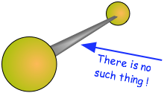

Slide 6
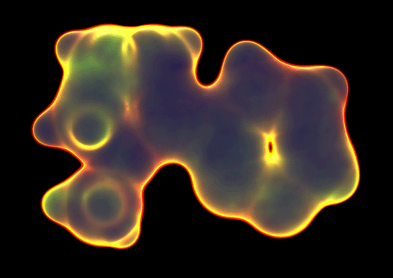

Slide 7
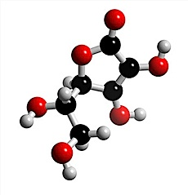
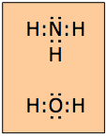
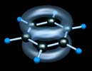
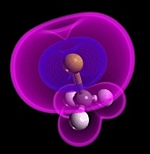
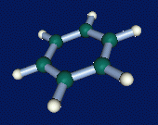
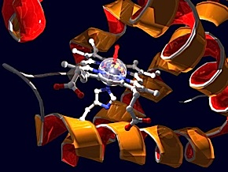
Chemical Models

Slide 8
LET’S
FIRST
REVIEW
IONIC
BONDING

Slide 9
In an IONIC bond,
electrons are lost or gained,
resulting in the formation of IONS
in ionic compounds.
K
F

Slide 10
K
F

Slide 11
K
F

Slide 12
K
F

Slide 13
K
F

Slide 14
K
F

Slide 15
K
F

Slide 16
_
K
+
F

Slide 17
_
K
+
F
The compound potassium fluoride
consists of potassium (K⁺) ions
and fluoride (F⁻) ions

Slide 18
_
K
+
F
The ionic bond is the attraction
between the positive K⁺ ion
and the negative F⁻ ion

Slide 19
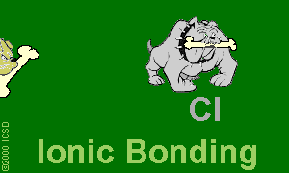
Ionic Bonds: One Big Greedy Thief Dog!

Slide 20
So
what
are
covalent
bonds?

Slide 21
In covalent bonding,
atoms still want to achieve
a noble gas configuration
(the octet rule).

Slide 22
In covalent bonding,
atoms still want to achieve
a noble gas configuration
(the octet rule).
But rather than losing or gaining
electrons,
atoms now share an electron pair.

Slide 23
In covalent bonding,
atoms still want to achieve
a noble gas configuration
(the octet rule).
But rather than losing or gaining
electrons,
atoms now share an electron pair.
The shared electron pair
is called a bonding pair

Slide 24
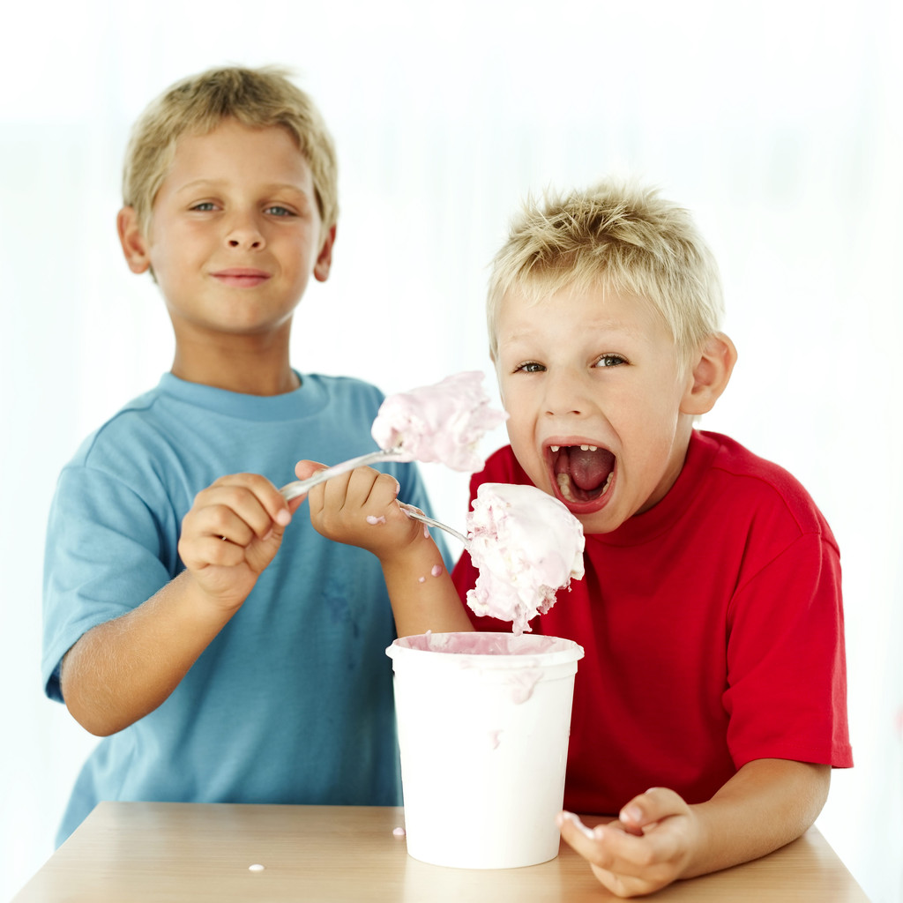
Covalent =Sharing

Slide 25
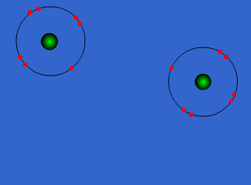
Covalent Bonds

Slide 26
Chlorine
forms
a
covalent
bond
with
itself
Cl₂

Slide 27
How
will
two
chlorine
atoms
react?
Cl
Cl

Slide 28
Cl
Cl
Each chlorine atom wants to
gain one electron to achieve an octet

Slide 29
Cl
Cl
Neither atom will give up an electron –
chlorine is highly electronegative.
What’s the solution – what can they
do to achieve an octet?

Slide 30
Cl
Cl

Slide 31
Cl
Cl

Slide 32
Cl
Cl

Slide 33
Cl
Cl

Slide 34
Cl
Cl
octet

Slide 35
Cl
Cl
octet
circle the electrons for
each atom that completes
their octets

Slide 36
Cl
Cl
The octet is achieved by
each atom sharing the
electron pair in the middle
circle the electrons for
each atom that completes
their octets

Slide 37
Cl
Cl
The octet is achieved by
each atom sharing the
electron pair in the middle
circle the electrons for
each atom that completes
their octets

Slide 38
Cl
Cl
This is the bonding pair
circle the electrons for
each atom that completes
their octets

Slide 39
Cl
Cl
It is a single bonding pair
circle the electrons for
each atom that completes
their octets

Slide 40
Cl
Cl
It is called a SINGLE BOND
circle the electrons for
each atom that completes
their octets

Slide 41
Cl
Cl
Single bonds are abbreviated
with a dash
circle the electrons for
each atom that completes
their octets

Slide 42
Cl
Cl
This is the chlorine molecule,
Cl₂
circle the electrons for
each atom that completes
their octets

Slide 43
O2
Oxygen is also one of the diatomic molecules

Slide 44
O
O
How will two oxygen atoms bond?

Slide 45
O
O
Each atom has two unpaired electrons

Slide 46
O
O

Slide 47
O
O

Slide 48
O
O

Slide 49
O
O

Slide 50
O
O

Slide 51
O
O

Slide 52
O
O
Oxygen atoms are highly electronegative.
So both atoms want to gain two electrons.

Slide 53
O
O
Oxygen atoms are highly electronegative.
So both atoms want to gain two electrons.

Slide 54
O
O

Slide 55
O
O

Slide 56
O
O

Slide 57
O
O

Slide 58
O
O
Both electron pairs are shared.

Slide 59
O
O
6 valence electrons
plus 2 shared electrons
= full octet

Slide 60
O
O
6 valence electrons
plus 2 shared electrons
= full octet

Slide 61
O
O
two bonding pairs,
making a double bond

Slide 62
O
O
O
O
=
For convenience, the double bond
can be shown as two dashes.

Slide 63
O
O
=
this is so cool!!
This is the oxygen molecule,
O2

Slide 64
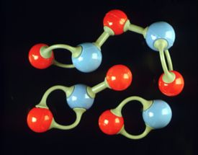
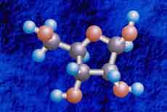
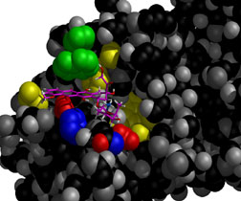

Slide 65
Bonds in all the polyatomic ions and diatomics are all covalent bonds

Slide 66
POLAR COVALENT BONDS
when electrons are shared but shared unequally
H2O

Slide 67
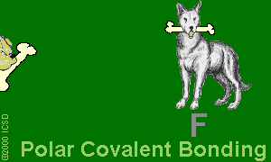
Polar Covalent Bonds: Unevenly matched, but willing to share.

Slide 68
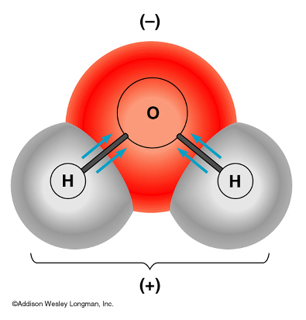
- water is a polar molecule because oxygen is more electronegative than hydrogen, and therefore electrons are pulled closer to oxygen.

Slide 69
METALLIC BOND bond found in metals; holds metal atoms together very strongly

Slide 70
Metallic Bond
Formed between atoms of metallic elements
Electron cloud around atoms
Good conductors at all states, lustrous, very high melting points
Examples; Na, Fe, Al, Au, Co

Slide 71
Metallic Bonds: Mellow dogs with plenty of bones to go around.

Slide 72
Ionic Bond, A Sea of Electrons

Slide 73
Metals Form Alloys
Metals do not combine with metals. They form
Alloys which is a solution of a metal in a metal.
Examples are steel, brass, bronze and pewter.

